Slide 1
15CSE402 Structure and Interpretation of Computer Programs
Building abstraction with data

Slide 2
Data Abstraction
Idea is to build complex data by combining primitive or compound data objects.
A methodology that enables to separate the details of how the complex data is used from the details of how the data is constructed from primitive data objects.
Example: Rational Number can be manipulated easily considering its denominator and numerator part as a single data unit.

Slide 3
Data Abstraction
Advantages:
Increases the modularity and expressive power.
Allows to deal with data at higher conceptual level than the primitive data objects..
Allows to conceptually manipulate the complex data as a single unit.
Allows combining primitive and compound data objects to build complex objects.

Slide 4
Data Abstraction
Abstract data hides the details of the complex data generation and can be treated as a single unit.
The programs manipulating abstract data and the programs representing the abstract data are independent of each other.
Selectors and Constructors provide an interface between these two.

Slide 5


Example: Rational Numbers
They are of the form (numerator / denominator) ans can be represented by:
A constructor :
(make-rat <n> <d>)
It returns a rational number with numerator <n> and denominator <d>, where <n> & <d> are integers.
Selectors:
numer <x>
denom <x>
numer <x> and denom <x> return numerator and denominator of rational number <x>
x= $\frac{3}{4}$
numer of x is 3
denom of x is 4

Slide 6


Rational Numbers
Operations on Rational Number:
Addition:
Subtraction:
$\frac{2}{3}+\frac{1}{2}$= $\frac{7}{6}$
$\frac{2}{3}−\frac{1}{2}$= $\frac{1}{6}$
$\frac{2}{3}×\frac{1}{2}$= $\frac{2}{6}$
$\frac{2}{3}÷\frac{1}{2}$= $\frac{4}{3}$
Multiplication:
Division:

Slide 7
Rational Numbers
Operations on Rational Number:
(define (add-rat x y)
(make-rat (+ (* (numer x) (denom y))
(* (numer y) (denom x)))
(* (denom x) (denom y))))
(define (sub-rat x y)
(make-rat (- (* (numer x) (denom y))
(* (numer y) (denom x)))
(* (denom x) (denom y))))
(define (mul-rat x y)
(make-rat (* (numer x) (numer y))
(* (denom x) (denom y))))

Slide 8
Rational Numbers
Operations on Rational Number:
( (define (div-rat x y)
(make-rat (* (numer x) (denom y))
(* (denom x) (numer y))))
(define (equal-rat? x y)
(= (* (numer x) (denom y))
(* (numer y) (denom x))))
Note: make-rat, numer and denom procedures are undefined yet.
- We need to glue numerator and denominator to form a single object.
Addition:
Subtraction:

Slide 9
Pairs
Pair: A compound structure.
Cons : A primitive procedure that constructs a pair.
Input: Two objects
Output: Compound data object.
Eg: (cons 1 2)➔’(1.2)
car and cdr: Primitive procedures that return the parts / arguments of the compound object.
- car returns first argument.
- cdr returns second argument.
Constructed using cons

Slide 10
Pair
(define x (cons 1 2))
x
‘(1.2)
(car x)
1
(cdr x)
2
x is a compound object.
Returns 1st argument
Returns 2nd argument

Slide 11
Pairs
x, y and z can be used as primitive data objects
(define x (cons 1 2))
(define y (cons 3 4))
(define z (cons x y))
(car (car z))
1
(car (cdr z))
3
Data objects constructed from pairs are called list-structured data.

Slide 12
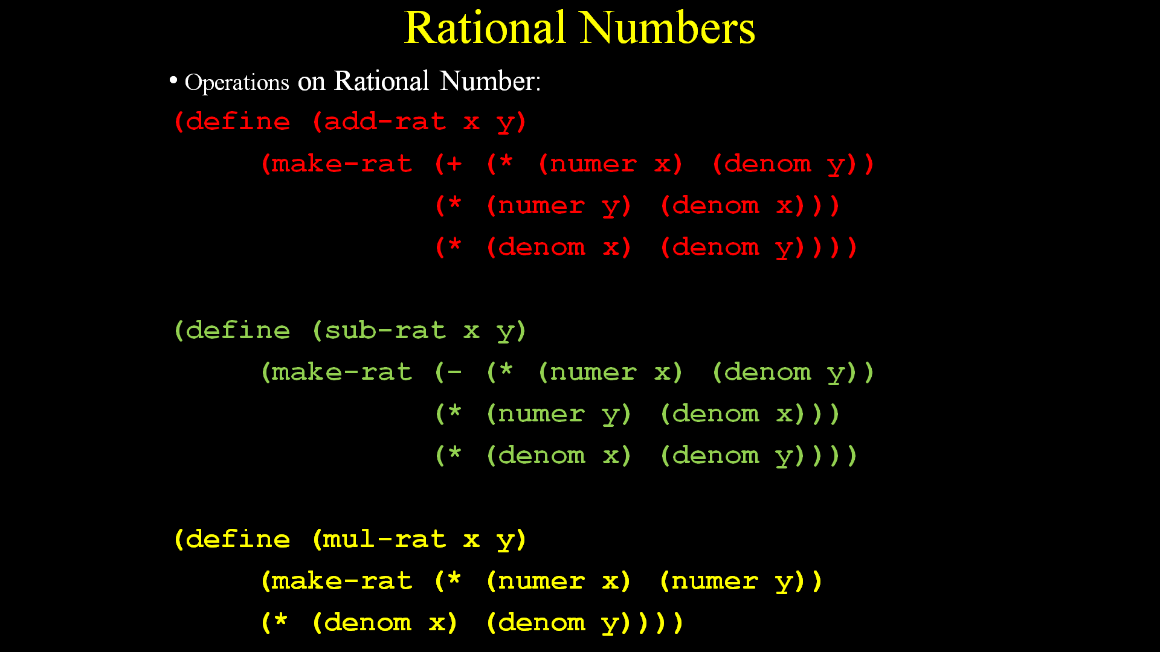
Rational numbers using pairs
Constructor: (define (make-rat n d)
(cons n d))
Selectors: (define (numer x) (define (denom x)
(car x)) (cdr x))

Slide 13
Rational numbers using pairs
(define (print-rat x)
(newline)
(display (numer x))
(display "/")
(display (denom x)))
Example:
(define one-half (make-rat 1 2))
(print-rat one-half)
1/2
Function for Printing

Slide 14



Rational numbers : Examples
(define x (make-rat 1 3))
(print-rat x)
(define y (make-rat 1 2))
(print-rat y)
(print-rat (add-rat x y))
(print-rat (mul-rat x y))
x=1/3
y=1/2
5/6
1/6

Slide 15
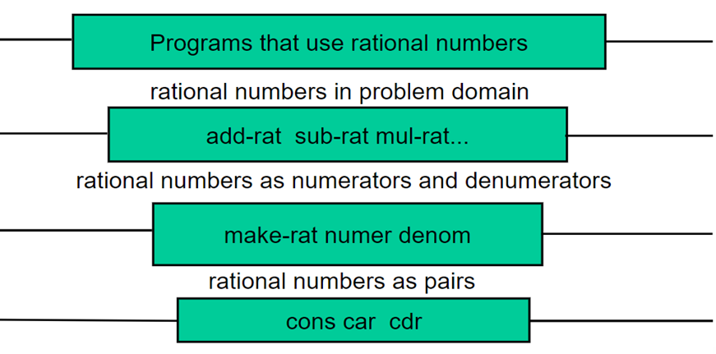
Abstraction Barriers
Each level is an abstraction and hides data from the levels above it

Slide 16
Abstraction Barrier: Problem
(define add-rat x y)
(cons (+ (* (car x) (cdr y))
(* (car y) (cdr x)))
(* (cdr x)(cdr y))))
By-passing an abstraction barrier creates problems for maintenance.
Change at one –level can have multiple effects on different levels.

Slide 17
Alternative approach for rational numbers
So far10000/20000 has been treated as it is.
Problems:
Additional computations.
Clumsy results.
Alternate solution is to simplify:
Approach – 1: Reducing to lowest terms in constructor
(define (make-rat n d)
(let ((g (gcd n d)))
(cons (/ n g) (/ d g))))

Slide 18
Alternative approach for rational numbers
Approach – 2: Reducing to lowest terms in selectors
(define (make-rat n d)
(cons n d))
(define (numer x)
(let ((g (gcd (car x) (cdr x))))
(/ (car x) g)))
(define (denom x)
(let ((g (gcd (car x) (cdr x))))
(/ (cdr x) g)))

Slide 19
Alternative approach for rational numbers
Observations:
- Procedures can be defined based upon the understanding of the programmer.
-Best practice is to code so that minimum operations are performed.
Approach 1: Including gcd() into make-rat().
Normalization with gcd() will be performed only at the time of creation of the rational no.
Approach 2: Including gcd() into numer() and Denom ()
Normalization with gcd() will be performed repeatedly whenever individual data items are accessed.

Slide 20
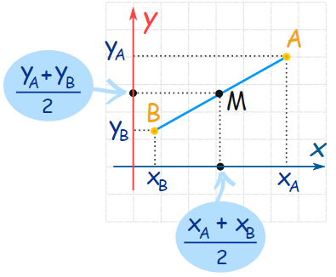
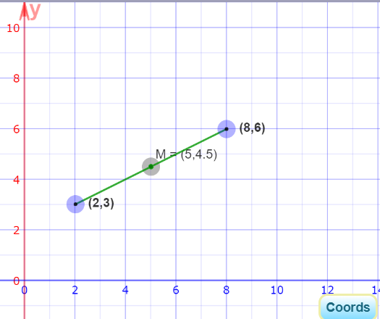
Example
Finding mid-point of a line segment using data abstraction. Consider the “point” to be pair of x-coordinate and y-coordinate. And “line” to be a pair of start-point and end-point.

Slide 21
Steps
Step-1: Creation of point ‘p1’ and ‘p2’in terms of (x,y)
(define (make-point x y) (cons x y))
(define p1 (make-point 2 3))
(define p2 (make-point 8 6))
Step-2: Extracting individual co-ordinates x and y.
(define (x-point p) (car p))
(define (y-point p) (cdr p))
(x-point p1)
(y-point p1)

Slide 22
Steps
Step-3: Printing points.
(define (print-point p)
(newline)
(display "(")
(display (x-point p))
(display ",")
(display (y-point p))
(display ")")
)
(print-point p1)
(print-point p2)

Slide 23
Steps
Step-4: Creating line-segment “line1” between ‘p1’ and ‘p2’
(define (make-segment start-point end-point)
(cons start-point end-point))
(define line1 (make-segment p1 p2))
Step-5: Extracting start-point and end-point of “line1”
(define (start-segment segment) (car segment))
(define (end-segment segment) (cdr segment))
(start-segment line1)
(end-segment line1)

Slide 24
Steps
Step-6 Printing line “line1”
(define (print-segment p)
(newline)
(display "(")
(display (start-segment p))
(display "--------------")
(display (end-segment p))
(display ")")
)
(print-segment line1)

Slide 25
Steps
Step-7: Define procedure for calculating mid-point.
(define (midpoint-segment seg)
(average-points (start-segment seg)
(end-segment seg)
))
Helping procedures:
(define (average-points a b)
(make-point (average (x-point a) (x-point b))
(average (y-point a) (y-point b))
)
)
(define (average a b)
(/ (+ a b) 2))
(define mp (midpoint-segment line1))
Extracts start and
end points
Extracts individual coordinates

Slide 26
What is meant by data?
You may say that ’data’ is numbers, characters, strings, pairs, lists, maps, sets and so on.
Procedures can also be manipulated as data.
Hence, procedures can also be called ‘data’
For example:
Let us re-consider the ‘pairs’ data structure in Scheme using procedures.
Previously, we viewed ‘pair’ as data manipulated using primitive procedures cons, car and cdr.

Slide 27
What is meant by data?
(define (pair x y)
(define (dispatch m)
(cond ((= m 0) x)
((= m 1) y)
(else (error "Argument not 0 or 1")))
)
dispatch)
(define (first p)
(p 0))
(define (second p)
(p 1))
Procedure (pair x y)
Acting as ‘’pair’’ data structure

Slide 28
What is meant by data?
(first (pair 3 4))
Expansion-1
(first (define (dispatch m)
(cond ((= m 0) 3)
((= m 1) 4)
(else (error "Argument not 0 or 1")))
)
dispatch)
Procedure (pair x y)
Acting as ‘’pair’’ data structure

Slide 29
What is meant by data?
(first (pair 3 4))
Expansion-1
(first (define (dispatch m)
(cond ((= m 0) 3)
((= m 1) 4)
(else (error "Argument not 0 or 1")))
)
dispatch)
(define (first p)
(p 0))
* Analogous to these steps

Slide 30
What is meant by data?
(first (pair 3 4))
Expansion-2
(pair 3 4) returns <procedure:dispatch>
(dispatch 0)
Expansion-3
3 ................. # Answer
Study for (second (pair 3 4))
(define (first p)
(p 0))
Compound data is obtained
Using procedures only.

Slide 31
What is meant by data?
Another approach (Using lambda procedures)
(define (pair x y)
(lambda (m) (m x y))
)
(define (first p)
(p (lambda (a b) a))
)
(first (pair 3 4))

Slide 32
What is meant by data?
Another approach (Using lambda procedures)
Step-1: (first (pair 3 4))
Step 2: (first (lambda (m) (m 3 4)))
Step 3:((lambda (m) (m 3 4)) (lambda (a b) a))
m=(lambda (a b) a)
Step 4:
Step 5: ((m 3 4))
Step 6: ((lambda (a b) a) 3 4)
Step 7: 3……………..Answer.
How to code second (p)?????
(define (first p)
(p (lambda (a b) a))
Compound data is obtained
Using procedures only.

